Slide 1
Python Django Framework
Prepared By: Prof. Swati Patel

Slide 2
What is Framework?
A framework is often a layered structure indicating what kind of programs can or should be built and how they would interrelate.

Slide 3
DJANGO
Django is a free and open-source web framework.
It is written in Python.
It follows the Model-View-Template (MVT) architectural pattern.
It is maintained by the Django Software Foundation (DSF)
It is used by several top websites like YouTube , Google ,Dropbox , Yahoo Maps, Mozilla , Instagram, Washington Times, Nasa and many more
Django was created in 2003 as an internal project at Lowrance Journal-World News Paper for their web development.
The Original authors of Django Framework are: Adrian Holovaty , Simon Willison
After Testing this framework with heavy traffics, Developers released for the public as open source framework on July 21st 2005.
The Django was named in the memory of Guitarist Django Reinhardt.
Official website: djangoproject.com

Slide 4
Difference between MVC & MVT design patterns
MVC
MVT
MVC has controller that drives both Model and View.
View tells how the user data will be presented.
In MVC, we have to write all the control specific code.
Modifications are difficult
Suitable for development of large applications
Flow is clearly defined thus easy to understand.
It doesn’t involve mapping of URLs.
Examples are ASP.NET MVC, Spring MVC etc .
MVT has Views for receiving HTTP request and returning HTTP response.
Templates are used in MVT for that purpose.
Controller part is managed by the framework itself.
Modifications are easy
Suitable both small and large applications.
Flow is sometimes harder to understand as compared to MVC.
URL pattern mapping takes place.
Django uses MVT pattern.

Slide 5
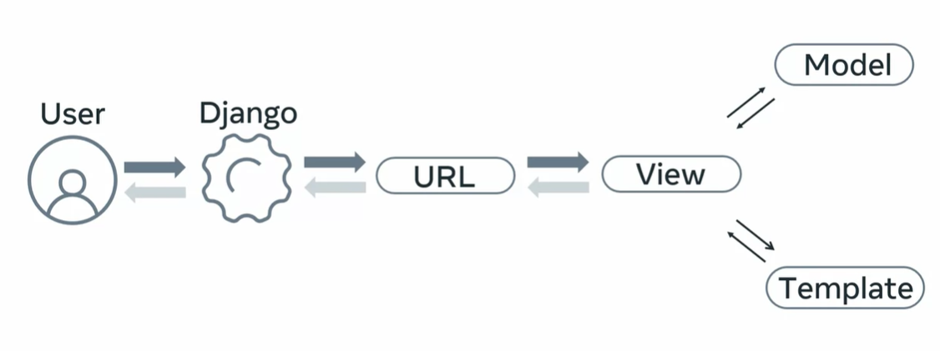
Django Project Design Flow

Slide 6
Top 5 Features of Django Framework:
Django was invented to meet fast-moving newsroom deadlines, while satisfying the tough requirements of experienced Web developers. The following are main important features of Django
Django
Framework
Fast
Fully loaded
Security
Scalability
Versatile
Django was designed to help developers take applications from concept to completion as quickly as possible.
Django includes dozens of extras we can use to handle common Web development tasks. Django takes care of user authentication, content administration, site maps, RSS feeds, and many more tasks.
Django takes security seriously and helps developers avoid many common security mistakes, such as SQL injection, cross-site scripting, cross-site request forgery and clickjacking. Its user authentication system provides a secure way to manage user accounts and passwords.
Some of the busiest sites on the planet use Django’s ability to quickly and flexibly scale to meet the heaviest traffic demands.
Companies, organizations and governments have used Django to build all sorts of things — from content management systems to social networks to scientific computing platforms.

Slide 7
Project files
__init__.py: It is a blank python script. Because of this special file name, Django treated this folder as python package
settings.py: In this file we have to specify all our project settings and configurations like installed applications, middleware configurations, database configurations etc.
urls.py: Here we have to store all our URL-patterns of our project. For every view (web page), we have to define separate URL-pattern. End user can use URL-patterns to access our webpages.
wsgi.py: wsgi -Web Server Gateway Interface. We can use this file while deploying our application in production on online server.
manage.py: The most commonly used python script is manage.py . It is a command line utility to interact with Django project in various ways like to run development server, run tests, create migrations etc.

Slide 8
App files
__init__.py: It is a blank Python script. Because of this special name, Python treated this folder as a package.
admin.py: We can register our models in this file. Django will use these models with Django’s admin interface.
apps.py: In this file we have to specify application's specific configurations.
models.py: In this file we have to store application's data models.
tests.py: In this file we have to specify test functions to test our code.
views.py: In this file we have to save functions that handles requests and return required responses.
Migrations Folder: This directory stores database specific information related to models.

